Slide 1


Slide 2
Classical theories
Scientific management
14 principles of management
Bureaucratic theory
Human relations
hawthorn studies
Contemporary theories

Slide 3
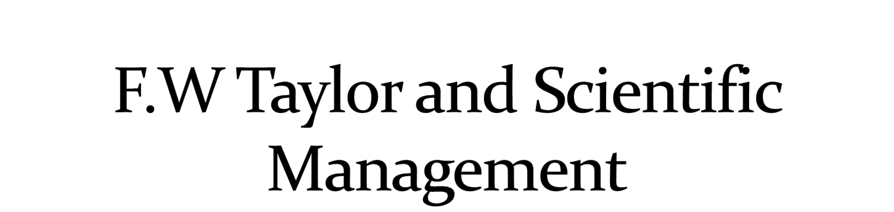

Slide 4
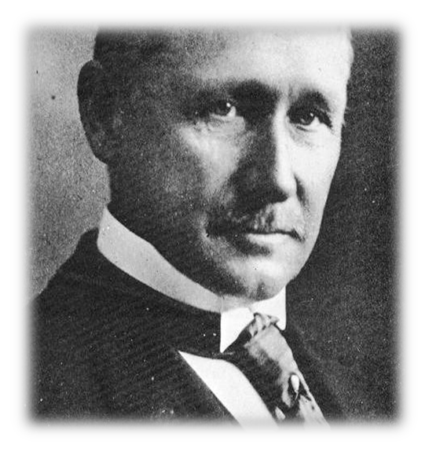

Frederick W. Taylor (1856- 1915)
founder of scientific Management
one of the first people to study the behavior and performance of people at work
was a manufacturing manager
became a consultant and taught other managers how to apply his scientific management techniques
believed that by increasing specialization and the division of labor, the production process will be more efficient.

Slide 5

The systematic study of relationships between people and tasks for the purpose of redesigning the work process to increase efficiency.
He developed 4 principles

Slide 6

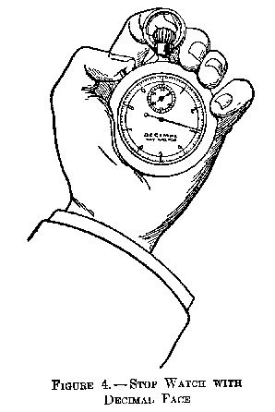

Management should scientifically develop a true science for each job.
Study the way workers perform their tasks, gather all the informal job knowledge that workers posses, and experiment with ways of improving how tasks are performed.
Codify the new methods of performing tasks into written rules and standard operating procedures.

Slide 7
2. Scientific selection training and development
selection means to choose the best employee according to the need. Their skill and experience must match the requirement of the job.
Scientific development refers to criteria for promotions, transfers etc.. So that work is done with full efficiency.
Carefully select workers who possess skills and abilities that match the needs of the task, and train them to perform the task according to the established rules and procedures.

Slide 8


Management should cooperate with the workers to ensure that work carried out in the prescribed way.
Establish a fair or acceptable level of performance for a task, and then develop a pay system that provides a reward for performance above the acceptable level.

Slide 9

The division of work and responsibility between management and the workers
Where management should decide and workers should implement
The responsibility of workers and management should be properly divided & communicated so that they can perform them in an effective way and should be reward for the same.

Slide 10

. Henri Fayol made a contribution to the management theory by advocating for principles of management. The management principles must be flexible and adaptable to changing circumstances.
These principles may be influenced by the organisation structure in which the process of management takes place.
Fayol identified the following 14 principles of management

Slide 11

The entire work is divided into small tasks/jobs and each task/job is performed by a trained specialist.
“The intent of division of work is to produce more and better work from the same effort. Specialization is the most efficient way to use human effort.”

Slide 12
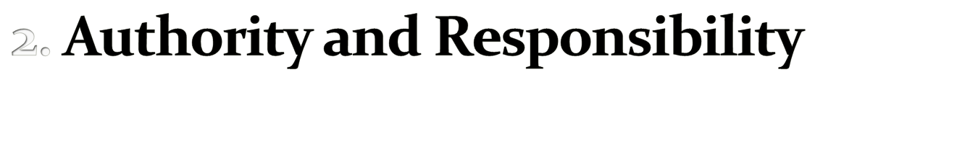
Whenever authority is exercised, responsibility follows. The application of sanctions is essential to good management and it is needed to encourage useful actions and to discourage their opposite.

Slide 13

This is essential for the efficient operation of the organisation
Discipline is in essence the outward mark of respect for agreements between the organisation and its members.

Slide 14

Both material order and social order are necessary. The former minimizes lost time and useless handling of materials. The latter is achieved through organization and selection.

Slide 15
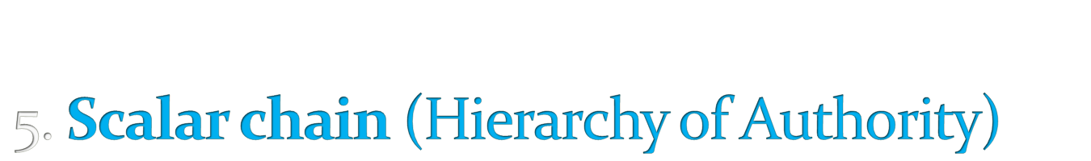
A hierarchy is necessary for unity of direction. But lateral communication is also fundamental, as long as superiors know that such communication is taking place. Scalar chain refers to the number of levels in the hierarchy from the ultimate authority to the lowest level in the organization. It should not be over-stretched and consist of too-many levels

Slide 16
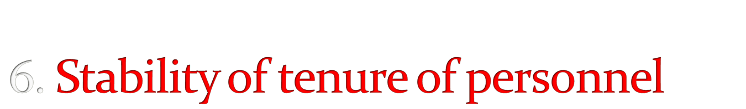
Generally, prosperous organisations have stable personnel levels, but changes of personnel are inevitable and stability of tenure is a question of proportion.
For the smooth running of an organisation labour turnover should be kept at minimal levels

Slide 17

Each worker should have only one boss with no other conflicting lines of command.
The employee should receive orders from one superior only, if not the authority is undermined and discipline, order and stability is threatened.
Dual command is a perpetual source of conflict. .

Slide 18

In order to provide for unity of action, coordination and focusing of effort, there should be one head and one plan for any group of activities with the same objective.
All activities with the same objective must have one plan with one head.
People engaged in the same kind of activities must have the same objectives in a single plan. This is essential to ensure unity and coordination in the enterprise.

Slide 19

In running a business a ‘combination of kindliness and justice’ is needed. Treating employees well is important to achieve equity.
There should be equity and equality of treatment in dealing with employees throughout all1evels of the scalar chain

Slide 20
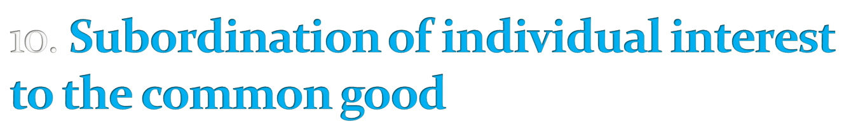
Management must see that the goals of the firms are always paramount.
Generally, prosperous organisations have stable managerial personnel, but changes of personnel are inevitable and stability of tenure is a question of proportion.

Slide 21
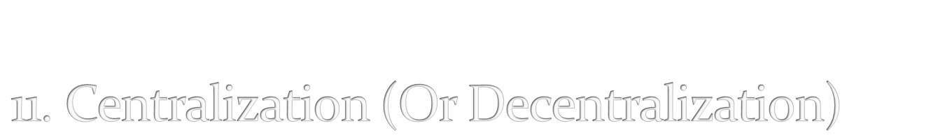
This is a matter of degree depending on the condition of the business and the quality of its personnel.
The extent of centralisation is a question of proportion and will vary with a particular organization

Slide 22

Payment is an important motivator although by analysing a number of possibilities, Fayol points out that there is no such thing as a perfect system.
Remuneration should as far as possible satisfy both the employee and the employer.
Methods of work can influence the organizational performance and it should be fair and should encourage keenness by rewarding well-deserved effort.

Slide 23
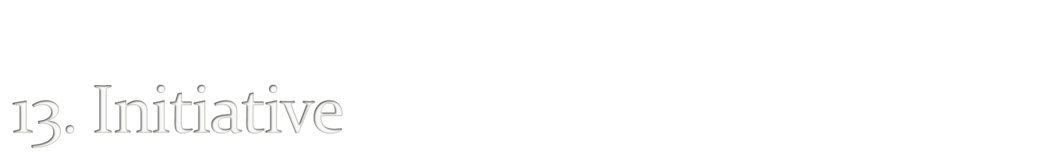
Allowing all personnel to show their initiative in some way is a source of strength for the organization. Even though it may well involve a sacrifice of ‘personal vanity’ on the part of many managers.

Slide 24

Management must foster the morale of its employees, as harmony and unity among members of the organisation is a great strength in the organisation.
The principle of unity of command should be observed to avoid the dangers of divide and rule of one's own team and abuse of written communication.
“real talent is needed to coordinate effort, encourage keenness, use each person’s abilities, and reward each one’s merit without arousing possible jealousies and disturbing harmonious relations.”

Slide 25

D=Division of Labour
A=Authority and Responsibility
D = Discipline
U = Unit of command
C = Centralisation
U = Unit of Direction
S = Scalar Chain (hierarchy of authority)
S = stability of tenure of personnel
R = Remuneration
O = Order
I = Initiative
S = Subordination of individual interest to the common good
E = Equity
E = Esprit de corps

